Slide 1
Wireless for the Internet of Things BLE Advertisement Deep Dive
CS/ECE 4501
Spring 2023
UVA
[Pannuto, Ghena, Nasir]

Slide 2
Today’s Goals
Recap BLE intro lecture
Find answers to some questions!
What are the real-world use cases of advertisements?
How much energy do advertisements take?
What is the probability of receiving a packet?
What is the probability of receiving data?

Slide 3
Outline
Recap
Communicating with advertisements
Advertisement Use Cases
Energy Use
Packet Collisions

Slide 4
Bluetooth Classic and BLE co-exist & have different use cases
Bluetooth Classic (around since 1999)
Continuous data communication
Can afford higher battery power requirements
Bluetooth Low Energy (introduced in v4.0)
Small amounts of data transfer
Low power requirements
“months or years” on small batteries
Ideal for IoT devices
Headphones
Mobile Photo
Printers
Switches
and Sensors
Fitness Trackers
Tracking Devices (eg: Apple AirTag)
Car BT Audio
Notes:
As mentioned before, devices needing continuous, short-range data and audio streaming use Bluetooth Classic. This version of Bluetooth is standard in wireless printers, keyboards, speakers, and in-car entertainment systems.
Similarly, Bluetooth Low Energy (LE) powers a range of computer peripherals and audio devices. But due to low power usage, it’s ideal for IoT devices like fitness monitors, smart watches, and the like.
smart home, health, sport, and fitness sectors.
Bluetooth latest core specification: v5.3

Slide 5
Bluetooth Low Energy Roles: Scanner, Advertiser
Advertisement:
“Current temp
is 76F"
Scanner
Advertiser
Notes:
Advertiser
Scanner
Central
Peripheral
https://community.nxp.com/t5/Wireless-Connectivity/A-view-on-Bluetooth-Low-Energy-stack-roles/m-p/380310

Slide 6
BLE Central and Peripheral roles are for connections
Advertisement:
“I’m the Living Room Light”
Connection Request
Connected (stops advertising)
Central
“Set light brightness to 50%”
Peripheral
(note: this is highly simplified)
Notes:
Advertiser
Scanner
Central
Peripheral
https://community.nxp.com/t5/Wireless-Connectivity/A-view-on-Bluetooth-Low-Energy-stack-roles/m-p/380310

Slide 7
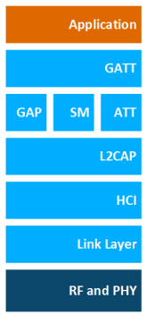
BLE Layers
GAP
Host – Configuration for advts, connections
GAP – Generic Access Profile
Configure advertising
GATT – Generic ATTribute profile
Configure connections
HCI - Host Controller Interface
Controller - Communication
Link Layer – send packets
RF and PHY – send bits
Host
Controller
Notes:
L2CAP: Logical Link Control and Adaptation Protocol. L2CAP acts as a protocol multiplexer and handles segmentation and reassembly
of packets. It also provides logical channels, which are multiplexed over one or more logical links. The L2CAP used in Bluetooth
low energy technology is an optimized and simplified protocol based on the classic Bluetooth L2CAP. Typically, application developers do not need to care about the details of interacting with the L2CAP layer.

Slide 8
What’s the need for the HCI Layer?
BT Classic envisioned separate implementations for Host and Controller
Controller layers run
on BLE hardware
Host layers run
on computer
HCI can be software API,
or physical (USB, RS232,..)
Notes:
Source: https://www.amd.e-technik.uni-rostock.de/ma/gol/lectures/wirlec/bluetooth_info/hci.html

Slide 9
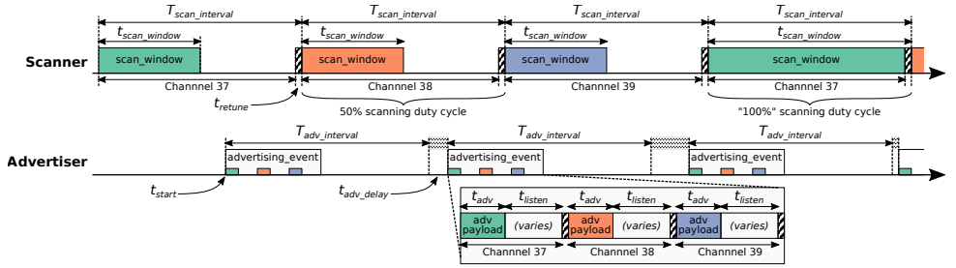
Advertisement and Scanning in Action
Advertisements are received when the channel of the scan window and the channel of the advertisement overlap in time (and space)
Notes:
3 advertisement channels (37, 38, 39) one after the other always in that order
Channel hopping
Random delay to prevent collisions
Scanner - periodically scans

Slide 10
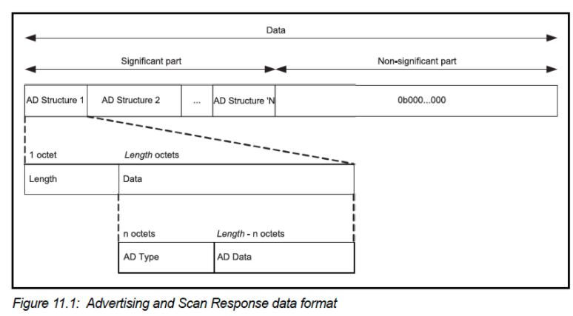
Advertisement payloads are in Length – Type – Value Format
Scanner can hop through length/type pairs to find what interests it
Name
Service UUID
TX Power Level
Manufacturer-specific data
And about twenty others
Flags

Slide 11
Outline
Recap
Communicating with advertisements
Advertisement Use Cases
Energy Use
Packet Collisions

Slide 12
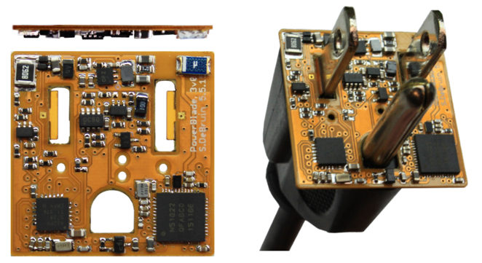
Advertisements already being used for communication
BLE advertisements: uncoordinated, broadcast messages originally designed for discovery
Devices are being deployed using just advertisements.
Beacons – iBeacon, Eddystone
Tracking – Tile, Apple AirTag
Local communication – Apple Continuity
Sensor deployments – PowerBlade
PowerBlade
Notes:
PowerBlade is a great example of this.
It’s a plug-load power meter
Initially configured to use advertisements as a simple method for reading measurements with a smartphone
We are interested in household deployments where dozens of PowerBlades will be deployed to measure all the loads in a home
Can we still use BLE advertisements for data transfer in the presence of many other devices?

Slide 13
Beacons to advertise presence and send out useful information
iBeacon and Eddystone
Popular formats for sending URLs and device identifiers
Use existing BLE fields (Service Data and Manufacturer-Specific Data)
Self-guided tours at museums

Slide 14
BLE signals can be used to track distance to items
Find my X
Tile, AirTag: find my keys
Apple: find my device
Find devices nearby
Get a sense of distance to the device
Notes:
https://iotandelectronics.wordpress.com/2016/10/07/how-to-calculate-distance-from-the-rssi-value-of-the-ble-beacon/
Measured power

Slide 15
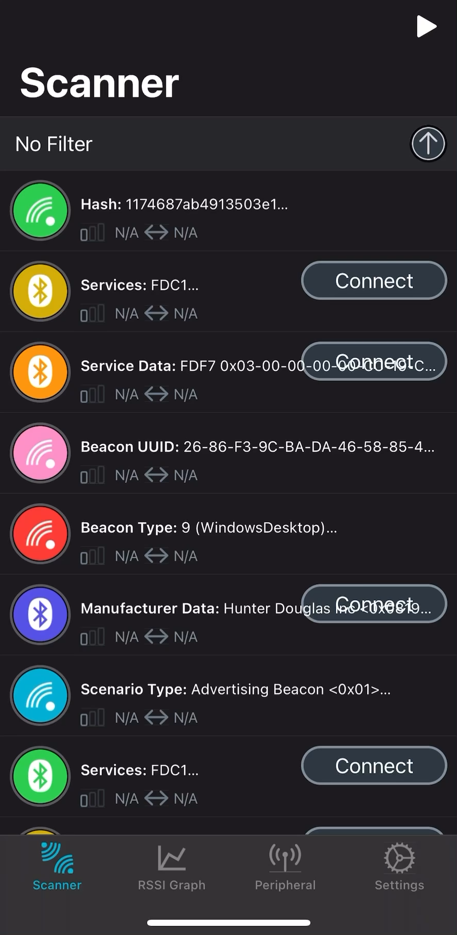
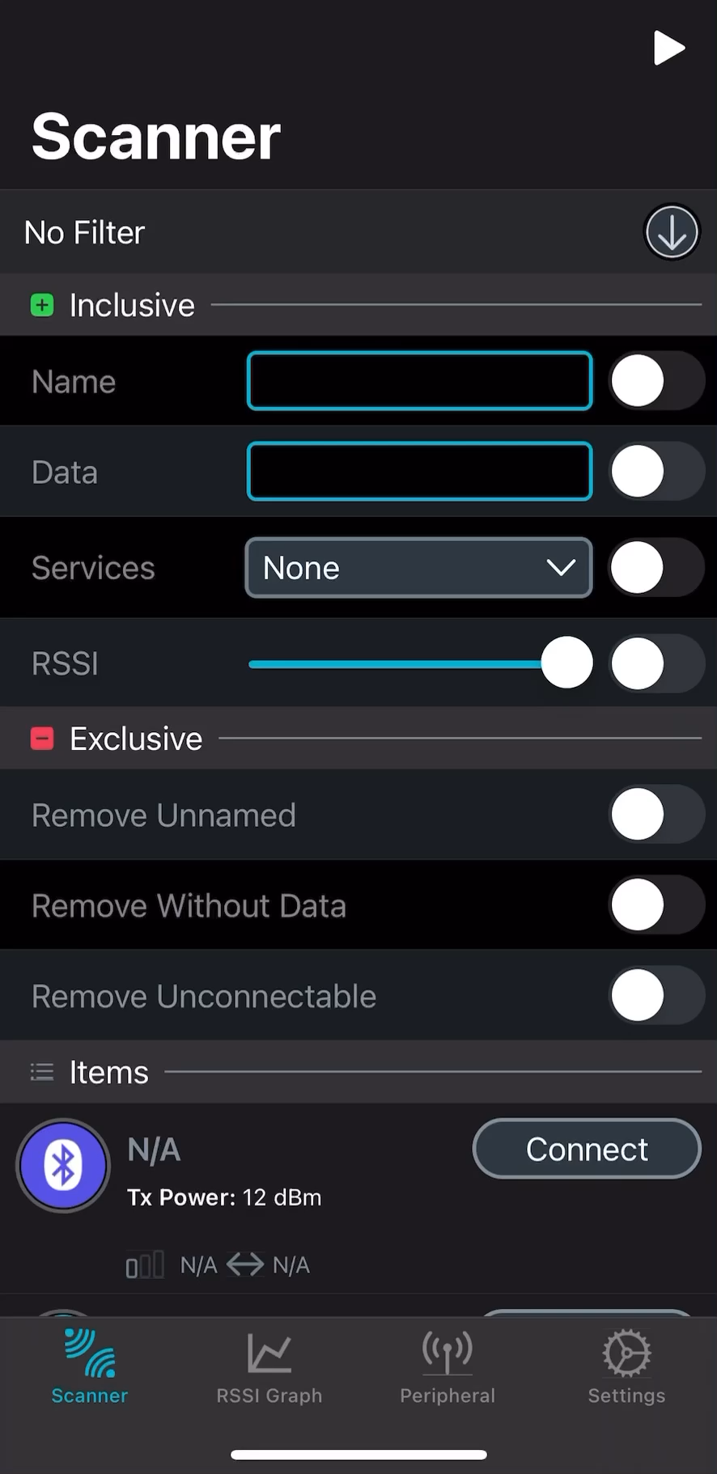
The promised nRF Connect Activity
Work in pairs with your neighbor
Open nRF Connect app on both smartphones
1 person becomes Advertiser
Other person becomes Scanner
Advertiser:
Go to Peripheral
Set a name for your Advertiser
Start Advertising
Scanner:
Start scan (Play button on top right)
Filter by Advertiser’s name
Go to RSSI viewer
Advertiser
Scanner

Slide 16
RSSI and some questions
RSSI (Received Signal Strength Indicator): Strength of beacon’s signal as seen on receiving device
What’s the lowest RSSI value you notice? How close to the advertiser is this?
What do you notice about RSSI when moving away from the advertiser?

Slide 17
Intuition on using signal strength to find distance
RSSI (Received Signal Strength Indicator): Strength of beacon’s signal as seen on receiving device
Measured Power: -20dBm
factory-calibrated, read-only constant
RSSI from
received signal
“Hey you should be getting an
RSSI of -20dBm at 1m distance
from me”
Can roughly figure out
how far the beacon is

Slide 18
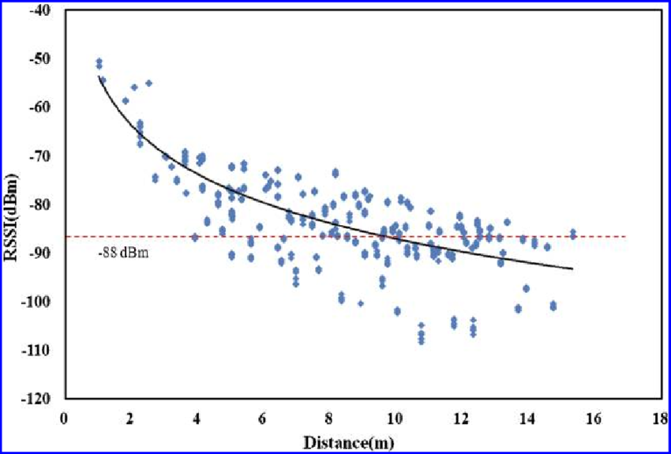
Problem with RSSI-based distance – not accurate
Pathloss is NOT only due to distance
RSSI is way worse at this than you hope it would be

Slide 19
Apple uses BLE on its devices to implement “Continuity”
Key part of Apple’s “ecosystem”, including:
Handoff
start tasks on one device and continue on another device
Universal Clipboard,
copying of data from one Apple device and pasting on another
iPhone Cellular Calls
make calls using iPhone’s cellular connection on Mac or iPad

Slide 20
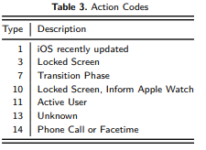
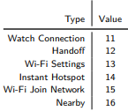
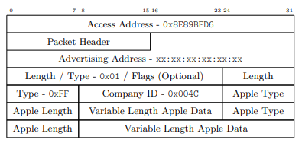
Uses BLE Manufacturer Specific Data to communicate
Communication with only nearby devices
Martin, Jeremy, et al. "Handoff all your privacy–a review of apple’s bluetooth low energy continuity protocol." Proceedings on Privacy Enhancing Technologies 2019.4 (2019): 34-53.
Notes:
https://btprodspecificationrefs.blob.core.windows.net/assigned-numbers/Assigned%20Number%20Types/Assigned%20Numbers.pdf

Slide 21
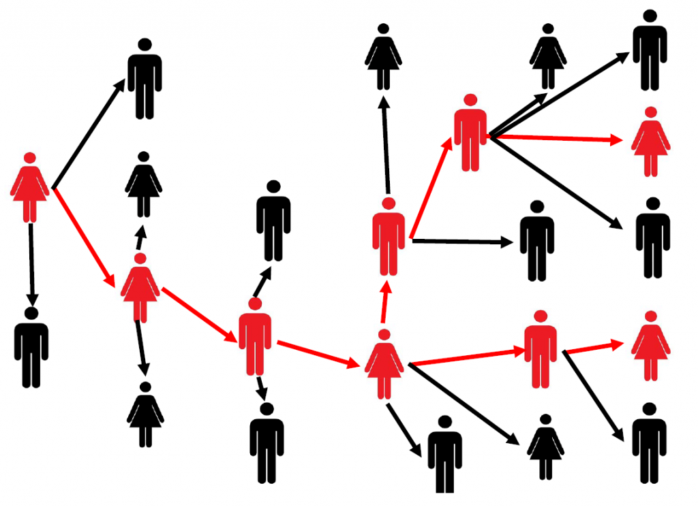
Local Communication: Exposure Notifications
Apple and Google collaboration to use phones for contact tracing
Government/healthcare system required on backend to flag sick people
Notes:
https://phii.org/sites/default/files/DT4CT%20White%20Paper_6.30.20-v2.pdf
Smartphone constantly broadcasts identifier.
Periodically, each smartphone listens for broadcasts around it.
Check list of identifiers to see if you’ve been around someone who is sick.
system interactions to determine when an identifier should be flagged as sick
24 states (not Illinois) adopted this

Slide 22
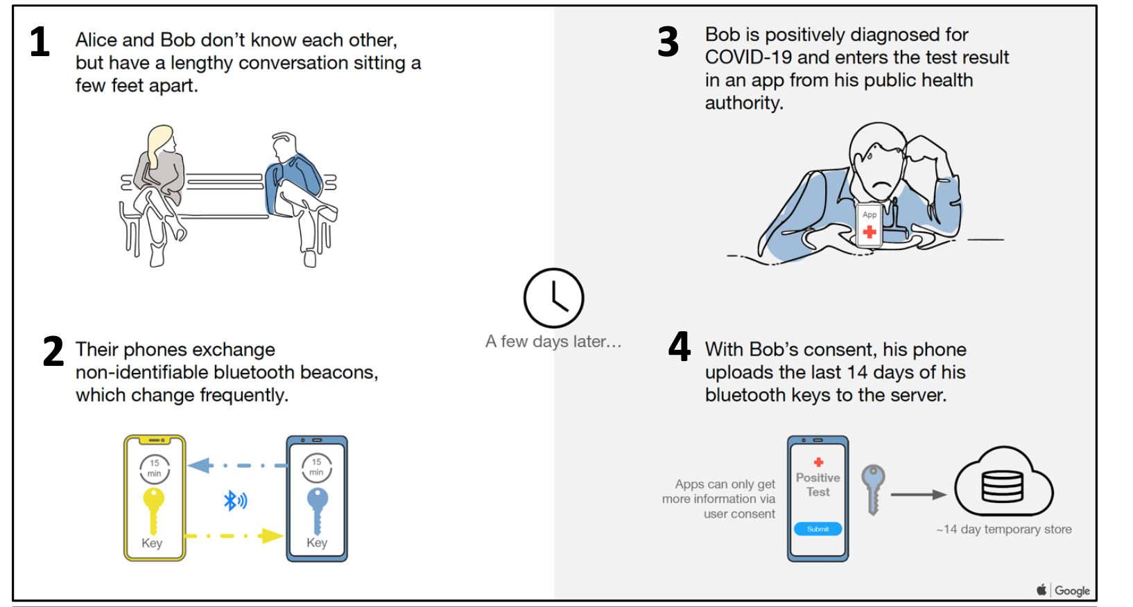

Slide 23
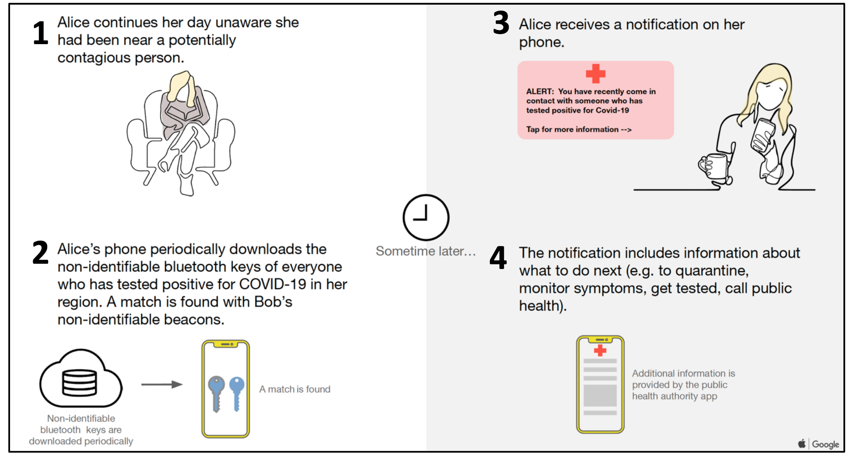

Slide 24
Sensor deployments
Report data so gateways and users can retrieve it simultaneously
Easy introspection during a deployment
Satisfy users’ curiosity
Ignore difficult questions about networking
Just broadcast the data!
DeBruin, Samuel, et al. "Powerblade: A low-profile, true-power, plug-through energy meter." Proceedings of the 13th ACM Conference on Embedded Networked Sensor Systems. 2015.

Slide 25
Outline
Recap
Communicating with advertisements
Advertisement Use Cases
Energy Use
Packet Collisions

Slide 26
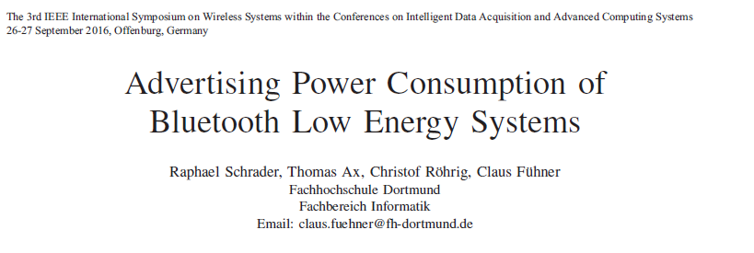
Paper: power measurements of BLE advertisements
Schrader, Raphael, et al. "Advertising power consumption of bluetooth low energy systems." 2016 3rd International Symposium on Wireless Systems within the Conferences on Intelligent Data Acquisition and Advanced Computing Systems (IDAACS-SWS). IEEE, 2016.

Slide 27
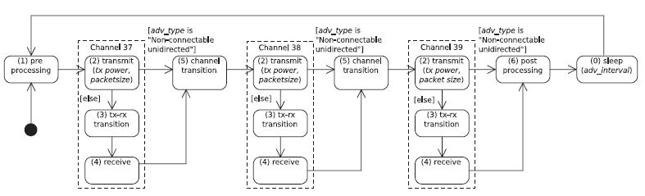
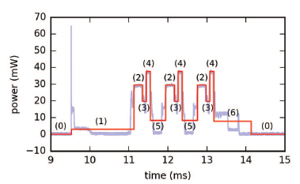
Energy model for BLE advertisements
Creates a set of states and metrics for how much power each uses and for what duration
power * duration = energy

Slide 28
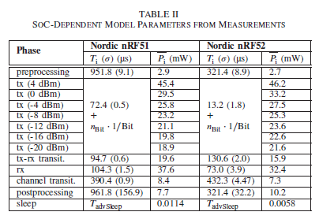
Power measured for BLE adv states for hardware
Power use and duration energy measured on
nRF51 Development Kit (nRF51822 System-on-Chip)
nRF52 DK (nRF52832 SoC)
Developed by Nordic Semiconductor
nRF51 DK
nRF51822 SoC

Slide 29
How much energy does it cost to send data over advertisements?
Configuration
nRF51822 SoC
Maximum payload size
+4 dBm transmit power
Connectable advertisement
Sleep power 11 µW
One packet per second example:
110 µW average
~270 days on a CR2032
One packet per minute example:
13 µW average
~2250 days (6yrs) on a CR2032

Slide 30
Outline
Recap
Communicating with advertisements
Advertisement Use Cases
Energy Use
Packet Collisions

Slide 31
Questions about network capability
What are the odds that a transmitted advertisement will be received?
Packet reception rate
If M redundant advertisements are sent instead, what are the odds that at least one is received?
Data reception rate
How do these odds vary with number of devices, advertising interval, and packet size?

Slide 32
BLE advertisements are periodic, broadcast transmissions
Advertisement events occur periodically (T_{adv_interval}: 20 ms–10 s).
Random delay appended before each transmission (t_{adv_delay}: 0–10 ms).
Data payload of up to 31 bytes.
advertisement event
advertisement event
t_{adv_delay}
time
T_{adv_interval}
+ t_{adv_delay}
Bluetooth SIG. Bluetooth Core Specification 4.2. (2014).
Notes:
How does communication work with BLE advertisements?
Each advertisement has a payload, which we can place sensor data in.
If data naturally has a periodic update rate, we can match the advertisement interval to that, so each advertisement has new sensor data.

Slide 33
What causes transmissions not to be received?
Not within range of the gateway
Or various other losses within the gateway itself
Two devices try to send at the same time (packet collision)
X
X
broadcast domain

Slide 34
Let’s define some terms for a single advertiser
time
T_{adv}
t_{adv_delay}
T_{adv}
Packet 0
Next Packet
T_{adv_interval}
T_{adv}: Transmission Time for packet
t_{adv_delay}: Random advertisement delay
T_{advInterval}: Advertisement interval
Jeon, Wha Sook, et al. "Performance analysis of neighbor discovery process in bluetooth low-energy networks." (IEEE Transactions on Vehicular Technology, 2016). Perez-Diaz de Cerio, David, et al. "Analytical and experimental performance evaluation of BLE neighbor discovery process including non-idealities of real chipsets." (Sensors, 2017).

Slide 35
Collisions occur if any part of the two packets overlap
t - T_{adv}
t
t + T_{adv}
time
T_{adv}
T_{adv}
T_{adv}
Packet 0
Packet 1
Packet 1
Packet 1
no collision
Packet 1
no collision
Packet 1
Vulnerable period
2 * T_{adv}
Jeon, Wha Sook, et al. "Performance analysis of neighbor discovery process in bluetooth low-energy networks." (IEEE Transactions on Vehicular Technology, 2016). Perez-Diaz de Cerio, David, et al. "Analytical and experimental performance evaluation of BLE neighbor discovery process including non-idealities of real chipsets." (Sensors, 2017).

Slide 36
Collisions occur if any part of the two packets overlap
t - T_{adv}
t
t + T_{adv}
time
T_{adv}
T_{adv}
T_{adv}
Packet 0
Packet 1
Packet 1
Packet 1
no collision
Packet 1
no collision
Packet 1
Vulnerable period
2 * T_{adv}
Jeon, Wha Sook, et al. "Performance analysis of neighbor discovery process in bluetooth low-energy networks." (IEEE Transactions on Vehicular Technology, 2016). Perez-Diaz de Cerio, David, et al. "Analytical and experimental performance evaluation of BLE neighbor discovery process including non-idealities of real chipsets." (Sensors, 2017).

Slide 37
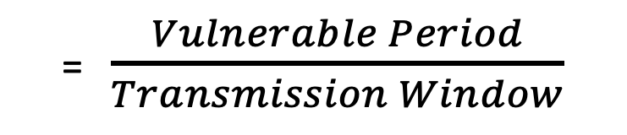
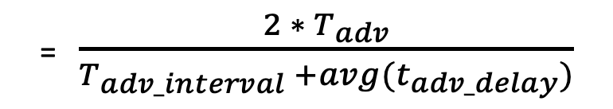
Computing probability of collision from vulnerable period and Tx window
t - T_{adv}
t
t + T_{adv}
time
T_{adv}
t_{adv_delay}
Packet 0
Packet 0
T_{adv_interval +} t_{adv_delay}
Transmission window
Vulnerable period
2 * T_{adv}
Probability of Collision
= $\frac{Vulnerable Period}{Transmission Window}$
= $\frac{{2 ∗ T}_{adv}}{T_{adv_interval} +avg(t_{adv_delay})}$

Slide 38
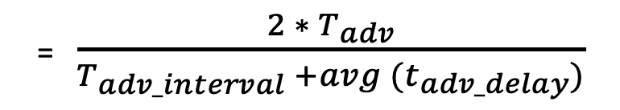
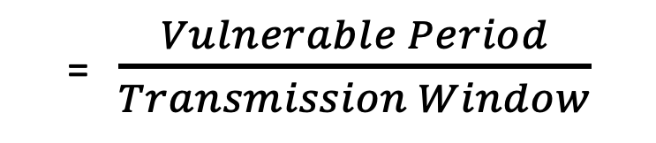
Determine Probability of Multiple Failures
Given:
Probability of Collision of 1 packet with reference packet
Determine:
Probability of Reception for data sent redundantly across M packets
Probability of Collision
= $\frac{Vulnerable Period}{Transmission Window}$
= $\frac{{2 ∗ T}_{adv}}{T_{adv_interval} +avg (t_{adv_delay})}$

Slide 39
Determine Probability of Multiple Failures
Given:
Probability of Collision of 1 packet with reference packet
Determine:
Probability of Reception for data sent redundantly across M packets
i.e., what are the odds that at least one of the packets doesn’t collide
Probability of Collision
= $\frac{Vulnerable Period}{Transmission Window}$
= $\frac{{2 ∗ T}_{adv}}{T_{adv_interval} +avg (t_{adv_delay})}$

Slide 40
Determine Probability of Multiple Failures
Given:
Probability of Collision of 1 packet with reference packet
Determine:
Probability of Reception for data sent redundantly across M packets
i.e., what are the odds that at least one of the packets doesn’t collide
1 – (Probability of Collision^{M})
(P_{c})^{M} = Probability that all of them collide
1-that = Probability that NOT all of them collide

Slide 41
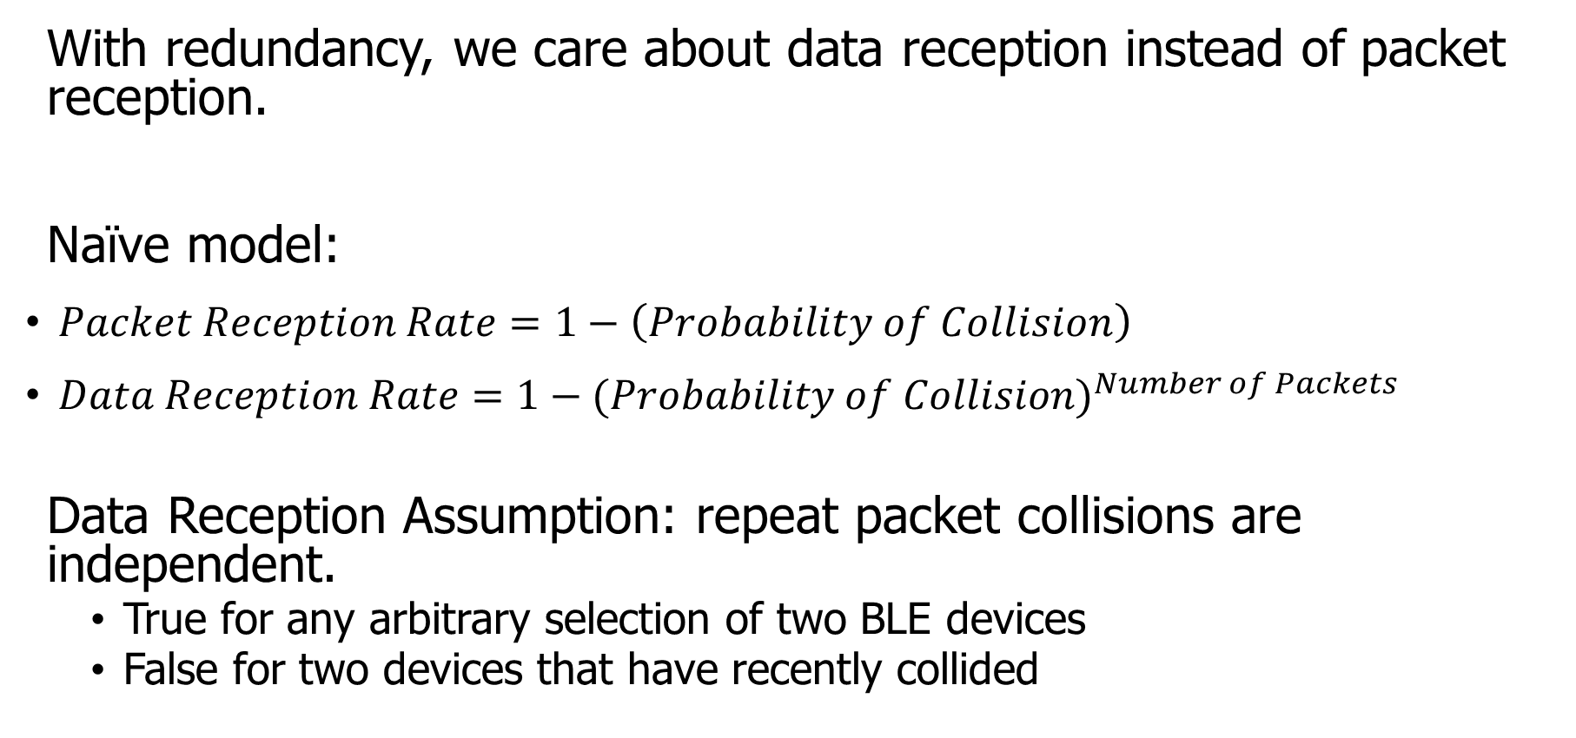
How do we determine reception rate?
With redundancy, we care about data reception instead of packet reception.
Naïve model:
$Packet Reception Rate=1−\left(Probability of Collision\right)$
$Data Reception Rate=1−{(Probability of Collision)}^{Number of Packets}$
Data Reception Assumption: repeat packet collisions are independent.
True for any arbitrary selection of two BLE devices
False for two devices that have recently collided
Notes:
Earlier we demonstrated the probability of collision, which can be used to determine packet reception rates.
Now with redundancy, we don’t care about the reception of any one packet, but the reception rate of the data that is being sent over them.
Naively, we can take the probability of collision and repeat it for any number of redundant packets.
There is an assumption in that model that repeat collisions are independent, which I’ll show you is false.

Slide 42
When are transmissions from two devices independent?
Assumption is true for any BLE device that has been advertising for some time
Sum of random delays grows the uncertainty of transmission.
Applied to periodic transmissions, any point in interval becomes equally likely.
Range of 1x delay, 2x delay, 3x delay, until it wraps
time
T_{adv_interval}
delay
T_{adv_interval}
delay
T_{adv_interval}
delay

Slide 43
When are transmissions from two devices NOT independent?
Independence assumption is false for two BLE devices that have recently collided.
If T_{adv_interval} is identical, next transmissions with be close in time.
Collision is determined by difference of random delays.
Further repeat collisions have the same probability of occurrence.
New time period collisions could occur within
time
T_{adv_interval}
delay
Notes:
If two devices have collided before, and have the same interval, at the next period they will certainly collide again.
BLE has a random delay appended to reduce this possibility.
But we’ve now greatly reduced the transmission window that the a collision could occur in. We can calculate this to determine a distinct probability of repeat collision.
Note that further repeat collisions are bounded by the same difference of random delays, and therefore have the probability of a second repeat collision is the same as the probability of a first repeat collision.

Slide 44
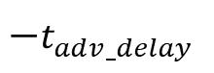
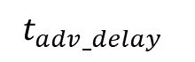

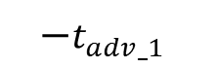

Calculating probability of a repeat collision
Difference of two uniform random delays forms a triangular distribution
probability
t_{adv_1}
t_{adv_0}
Probability of Repeat Collision
difference in transmission time
$$−t_{adv_delay}$$
$$−t_{adv_1}$$
$$0$$
$$t_{adv_0}$$
$$t_{adv_delay}$$
Source: Ghena, Branden R., Investigating Low Energy Wireless Networks for the Internet of Things, 2020.

Slide 45
Important lesson: spend time on things that are important
How important was accounting for repeat collisions?
Maximum error is about a 1% change in Data Reception Rate.
This is due to size of delay 10 ms compared to size of transmission ~300 µs.
200 ms interval advertisements

Slide 46
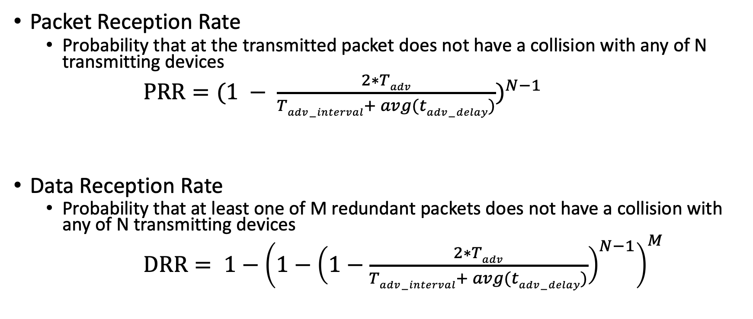
Equations for modeling data transmissions
Packet Reception Rate
Probability that at the transmitted packet does not have a collision with any of N transmitting devices
$PRR={(1 − \frac{2∗Tadv}{Tadv−interval+ avg(tadv−delay)})}^{N−1}$
Data Reception Rate
Probability that at least one of M redundant packets does not have a collision with any of N transmitting devices
$DRR= {1−\left(1−{\left(1−\frac{2∗Tadv}{Tadv−interval+ avg(tadv−delay)}\right)}^{N−1}\right)}^{M}$

Slide 47
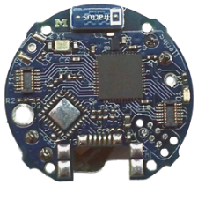
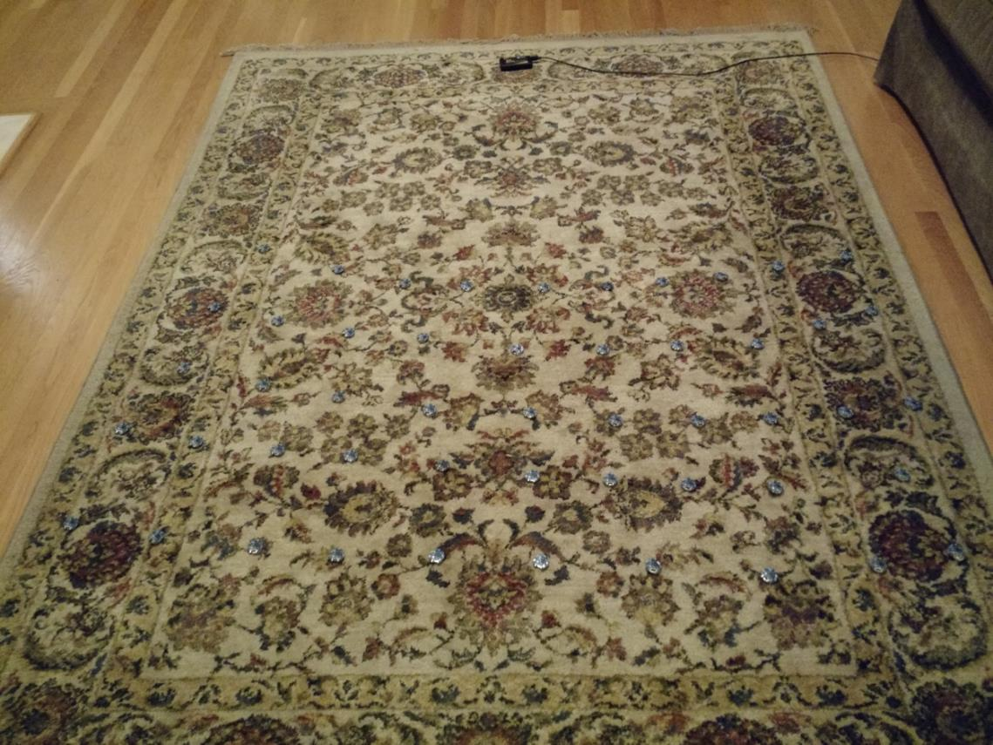
Is the model valid?
Empirical testing setup:
50 devices
1 meter from scanner
5-10 cm apart
Transmit monotonically increasing sequence numbers.
Sweep number of devices and advertising intervals.
Source: Ghena, Branden R., Investigating Low Energy Wireless Networks for the Internet of Things, 2020.

Slide 48
The model is accurate across advertisement rates and deployment sizes.
Accuracy is fairly consistent across intervals.
The model consistently overestimates the measured PRR values.
The effect could be due to RF interference.

Slide 49
The model accurately accounts for redundancy as well.
The same dataset can be used to measure the effect of redundancy by grouping sets of sequence numbers.
The model again slightly overestimates, but error reduces quickly as DRR approaches 100%.
Source: Ghena, Branden R., Investigating Low Energy Wireless Networks for the Internet of Things, 2020.

Slide 50
What questions can we answer with a collision model?
Original questions
What are the odds that a transmitted advertisement will be received?
If M redundant advertisements are sent instead, what are the odds that at least one are received?
How do these odds vary with number of devices, advertising interval, and packet size?
Additional questions
Can redundancy make advertisements reliable?
Is it better to transmit often for high redundancy or rarely for less congestion?

Slide 51
Redundancy results in high DRR even with many devices.
In this example, a sensor has new data once per second and sends it in 1-3 packets.
Even without redundancy, data reception rates never fall below 87% even with 200 devices in a deployment, assuming no interference.

Slide 52
Redundancy is (normally) better than less congestion.
Design question:
Send more packets to gain from redundancy? OR
Send less packets to reduce congestion?
The answer changes, but only with many devices.
Notes:
This plot changes with advertisement rate, and can get as low as 100 devices

Slide 53
Outline
Recap
BLE roles
Advertising
Scanning
Communicating with advertisements
Advertisement Use Cases
Energy Use
Packet Collisions
Bonus: Scan Responses

Slide 54
Scan requests/responses seem intriguing
Why not send most data in scan responses instead of advertisements?
Theoretically could reduce energy costs
Scan we use scan requests as a form of acknowledgement?
Could relieve need for redundant transmissions
Problem: scan requests/responses don’t work all that well

Slide 55
Scan Requests and Responses are broken
Goal: provide a little extra advertisement data on demand
Problem: exponential backoff for lost messages
If there is a request without a response, scanners assume collision with another scanner and exponentially back off from requesting
But collisions are far more likely between a device and a scanner, which should not have back off
Result is that scan requests will occur far less frequently than expected
Instead, just send additional advertisements with different data
Kravets, Robin, Albert F. Harris III, and Roy Want. "Beacon trains: blazing a trail through dense BLE environments." Proceedings of the Eleventh ACM Workshop on Challenged Networks. 2016.

